Slide 1
Unit-V
Searching Images

Slide 2
This topic shows how to use text mining techniques to search for images based on their visual content.
The basic ideas of using visual words are presented and the details of a complete setup are explained and tested on an example image data set.

Slide 3
Content-Based Image Retrieval
Content-based image retrieval (CBIR) deals with the problem of retrieving visually similar images from a (large) database of images.
This can be images with
similar color,
Similar textures, or
similar objects or scenes:
basically any information contained in the images themselves.

Slide 4
Visual Words
To apply text mining techniques to images, we first need to create the visual equivalent of words.
This is usually done using local descriptors like the SIFT—Scale-Invariant Feature Transform
The visual words are constructed using some clustering algorithm applied to the feature descriptors extracted from a (large) training set of images.
The most common choice is kmeans, algorithm

Slide 5
Visual words are nothing but a collection of vectors in the given feature descriptor space;
in the case of k-means, they are the cluster centroids.
Representing an image with a histogram of visual words is then called a bag-of visual-words model.

Slide 6
Indexing Images
Before we can start searching, we need to set up a database with the images and their visual word representations
Setting Up the Database
To start indexing images, we first need to set up a database.
Indexing images in this context means
extracting descriptors from the images,
converting them to visual words using a vocabulary, and
storing the visual words and word histograms with information about which image they belong to

Slide 7
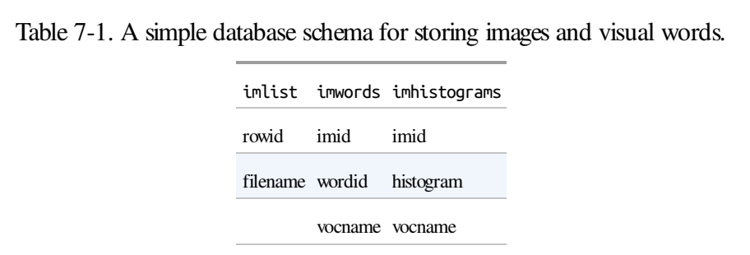
Here we will use SQLite as database.
SQLite is a database that stores everything in a single file and is very easy to set up and use.

Slide 8
Searching the Database for Images
With a set of images indexed, we can search the database for similar images.
Here we have used a bag-of-word representation for the whole image,
but the procedure explained here is generic and can be used to find
similar objects,
similar faces,
similar colors, etc.
It all depends on the images and descriptors used.

Slide 9
To handle searches, we introduce a Searcher class to imagesearch.py:
class Searcher(object): def __init__(self,db,voc): """ Initialize with the name of the database. ""“ self.con = sqlite.connect(db) self.voc = voc def __del__(self): self.con.close()

Slide 10
Ranking Results Using Geometry
One way to have the feature points improve results is to re-rank the top results using some criteria that takes the features geometric relationships
The most common approach is to fit homographies between the feature locations in the query image and the top result images

Slide 11
Here is what a complete example of loading all the model files and re-ranking the top results using homographies looks like:
import pickle import sift import imagesearch import homography # load image list and vocabulary with open('ukbench_imlist.pkl','rb') as f: imlist = pickle.load(f) featlist = pickle.load(f) nbr_images = len(imlist) with open('vocabulary.pkl', 'rb') as f: voc = pickle.load(f) src = imagesearch.Searcher('test.db',voc)

Slide 12
Building Demos and Web Applications
Creating Web Applications with CherryPy :
To build these demos, we will use the CherryPy package, available at http://www.cherrypy.org/.
CherryPy is a pure Python lightweight web server that uses an object oriented model

Slide 13
Image Search Demo
First, we need to initialize with a few html tags and load the data using Pickle.
We need the vocabulary for the Searcher object that interfaces with the database.
Create a file searchdemo.py and add the following class with two methods:

Slide 14
import cherrypy, os, urllib, pickle import imagesearch class SearchDemo(object): def __init__(self): # load list of images with open('webimlist.txt') as f: self.imlist = f.readlines() self.nbr_images = len(self.imlist) self.ndx = range(self.nbr_images) # load vocabulary with open('vocabulary.pkl', 'rb') as f: self.voc = pickle.load(f) # set max number of results to show self.maxres = 15 # header and footer html self.header = """ <!doctype html> <head> <title>Image search example</title> </head> <body>

Slide 15
self.footer = """ </body> </html> """ def index(self,query=None): self.src = imagesearch.Searcher('web.db',self.voc) html = self.header html += """ <br /> Click an image to search. <a href='?query='>Random selection</a> of images. <br /><br /> """ if query: # query the database and get top images res = self.src.query(query)[:self.maxres] for dist,ndx in res: imname = self.src.get_filename(ndx) html += "<a href='?query="+imname+"'>" html += "<img src='"+imname+"' width='100' />" html += "</a>" else:

Slide 16
Classifying Image Content
This chapter introduces algorithms for classifying images and image content.
We look at some simple but effective methods as well as state-of-the-art classifiers and apply them to two-class and multi-class problems
K-Nearest Neighbors ( k NN)
One of the simplest and most used methods for classification is the k-nearest neighbor classifier (kNN).
The algorithm simply compares an object to be classified with all objects in a training set with known class labels and
lets the k nearest vote for which class to assign.

Slide 17
class KnnClassifier(object): def __init__(self,labels,samples): """ Initialize classifier with training data. """ self.labels = labels self.samples = samples def classify(self,point,k=3): """ Classify a point against k nearest in the training data, return label. """ # compute distance to all training points dist = array([L2dist(point,s) for s in self.samples]) # sort them ndx = dist.argsort() # use dictionary to store the k nearest votes = {} for i in range(k): label = self.labels[ndx[i]] votes.setdefault(label,0) votes[label] += 1 return max(votes) def L2dist(p1,p2): return sqrt( sum( (p1-p2)**2) )

Slide 18
Bayes Classifier or naive Bayes classifier
Bayes classifier is a probabilistic classifier based on applying Bayes’ theorem for conditional probabilities.
The assumption is that all features are independent and unrelated to each other (this is the “naive” part).
Bayes classifiers can be trained very efficiently, since the model chosen is applied to each feature independently

Slide 19
class BayesClassifier(object):
def __init__(self):
""" Initialize classifier with training data. """
self.labels = [] # class labels
self.mean = [] # class mean
self.var = [] # class variances
self.n = 0 # nbr of classes
def train(self,data,labels=None):
""" Train on data (list of arrays n*dim).
Labels are optional, default is 0...n-1. ""“
f labels==None:
labels = range(len(data))
self.labels = labels
self.n = len(labels)
for c in data:
self.mean.append(mean(c,axis=0))
self.var.append(var(c,axis=0))

Slide 20
def classify(self,points):
""" Classify the points by computing probabilities
for each class and return most probable label. """
# compute probabilities for each class
est_prob = array([gauss(m,v,points) for m,v in zip(self.mean,self.var)])
# get index of highest probability, this gives class label
ndx = est_prob.argmax(axis=0)
est_labels = array([self.labels[n] for n in ndx])
return est_labels, est_prob

Slide 21
Support Vector Machines
Support Vector Machines (SVM) are a powerful type of classifiers that often give state-of-the art results for many classification problems.
In its simplest form, an SVM finds a linear separating hyper plane (a plane in higher-dimensional spaces) with the best possible separation between two classes.

Slide 22
The decision function for a feature vector x is
f(x) = w · x – b, where
w is the hyper plane normal and
b an offset constant The zero level of this function then ideally separates the two classes so that one class has positive values and the other negative.
The parameters w and b are found by solving an optimization problem on a training set of labeled feature vectors xi with labels yi ∈ {–1, 1}
so that the hyperplane has maximal separation between the two classes.

Slide 23


The normal is a linear combination of some of the training feature vectors
so that the decision function can be written
Here i runs over a selection of the training vectors
the selected vectors xi are called support vectors

Slide 24
Optical Character Recognition
Optical character recognition (OCR) is the process of interpreting images of hand- or machine-written text.
A common example is text extraction from scanned documents such as zip-codes on letters or book pages such as the library volumes in Google Books

Slide 25
Here we will look at a simple OCR problem of recognizing numbers in images of printed Sudokus.
Sudokus are a form of logic puzzles where the goal is to fill a 9 × 9 grid with the numbers 1 to 9
so that each column, each row, and each 3 × 3 sub-grid contains all nine digits.

Slide 26
Training a Classifier
For this classification problem we have ten classes, the numbers 1 . . . 9, and the empty cells. Let’s give the empty cells the label 0 so that our class labels are 0 . . . 9.
To train this ten-class classifier, we will use a dataset of images of cropped Sudoku cells.
In the file sudoku_images.zip are two folders, “ocr_data” and “sudokus”.
For now, take a look at the folder “ocr_data”.
It contains two subfolders with images, one for training and one for testing. The images are named with the first character equal to the class (0 . . . 9).
Figure 8-6 shows some samples from the training set.
The images are grayscale and roughly 80 × 80 pixels

Slide 27
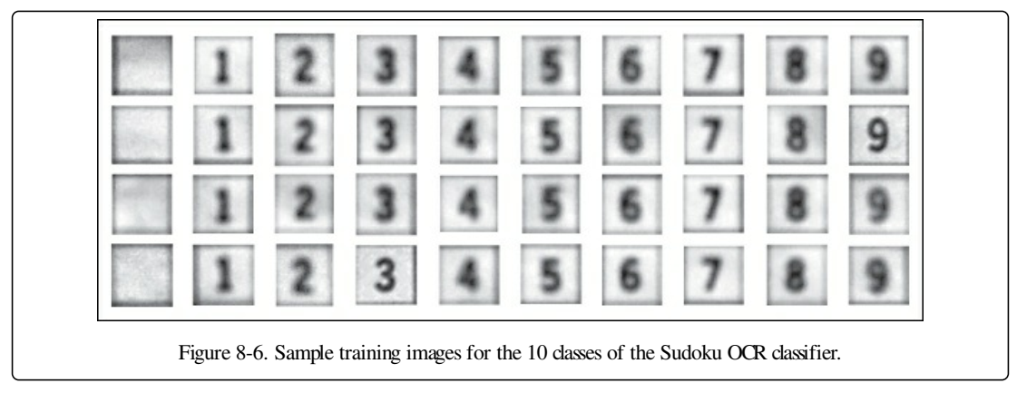

Slide 28
Example :
def compute_feature(im): """ Returns a feature vector for an ocr image patch. """ # resize and remove border norm_im = imresize(im,(30,30)) norm_im = norm_im[3:-3,3:-3] return norm_im.flatten()

Slide 29
